Slide 1
CS310 Operating Systems Lecture 40 : Hard Disk Storage
Ravi Mittal
IIT Goa

Slide 2
References
CS162, Operating Systems and Systems Programming, University of California, Berkeley
Various websites on the Internet

Slide 3
Reading
CS162, Operating Systems and Systems Programming, University of California, Berkeley
Book: Operating System Concepts, 10th Edition, by Silberschatz, Galvin, and Gagne

Slide 4
Lecture Contents
Persistent Storage Technologies
Hard Disk Drives
Solid State Drive (SDD)

Slide 5
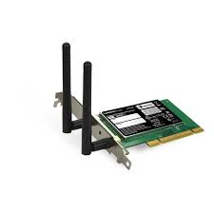
Where are we?
Running
Program 1
Running
Program 2
System Libs
System Libs
Compiler
Process 1
Process 2
Threads
Address Spaces
Files
Sockets
Threads
Address Spaces
Files
Sockets
Operating System
ISA
Processor
PgTbl
& TLB
Memory
Storage
Networks
Hardware
OS Mem
I/O Ctrlr
Kubiatowicz CS162 © UCB Spring 2021

Slide 6
Persistent Storage Technologies

Slide 7
Persistent Storage for File System
I/O API and
syscalls
Variable-Size Buffer
Memory Address
Logical Index, Typically 4 KB
File System
Block
Flash Trans. Layer
Hardware Devices
Sector(s)
Sector(s)
Sector(s)
Phys. Block
Phys Index., 4KB
Physical Index,
512B or 4KB
Erasure Page
HDD
SSD
CS162 © UCB Fa19

Slide 8
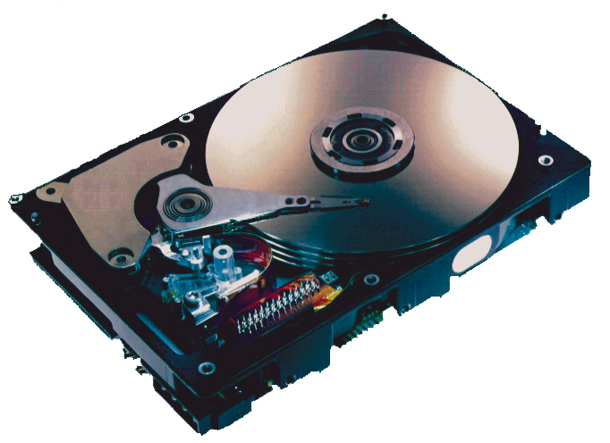
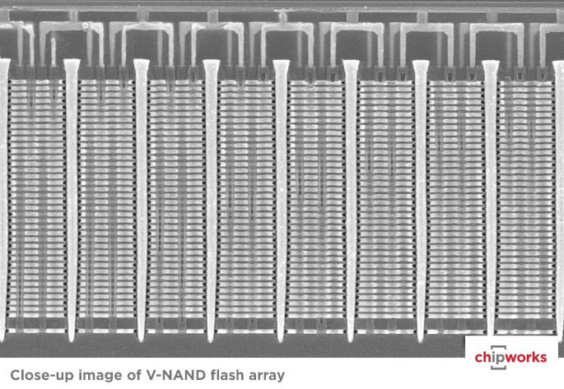
Storage Technologies
Magnetic Disks
Store on magnetic medium
Electromechanical access
Nonvolatile (Flash) Memory
Store as persistent charge
Implemented with 3-D structure
100+ levels of cells
3 bits data per cell
Bryant and O’Hallaron, Computer Systems: A Programmer’s Perspective, Third Edition

Slide 9
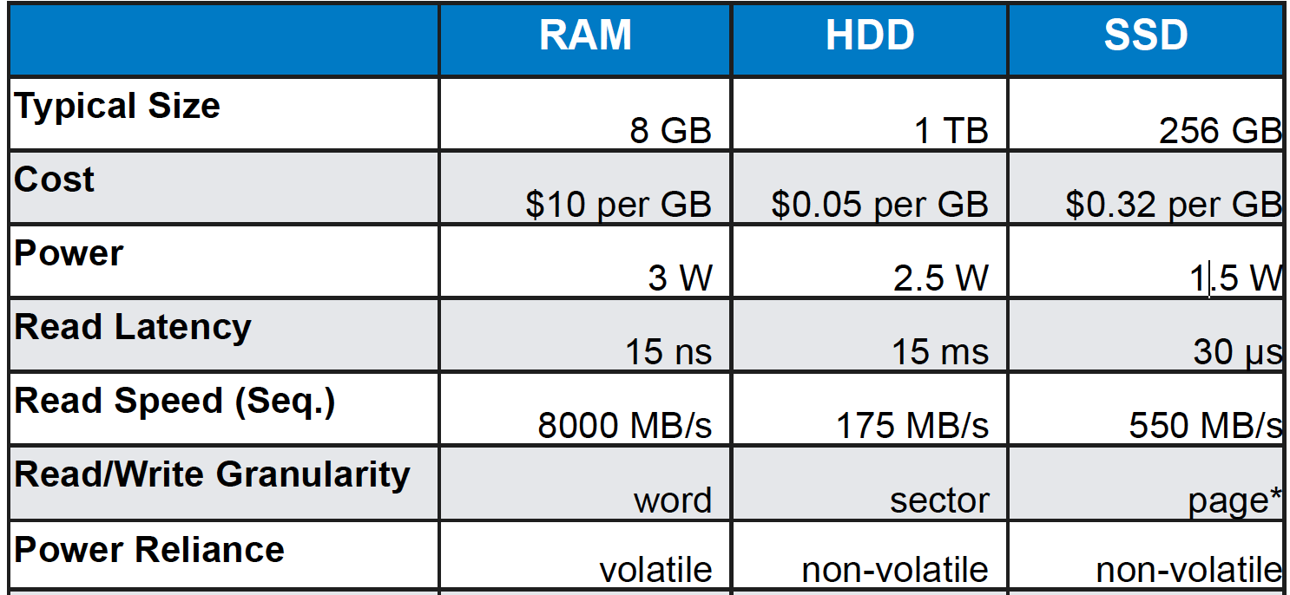
RAM vs Hard Disk vs SSD - 2018
In SSD Each cell has limited program/erase lifetime (thousands, for modern devices) – Cells become slowly less reliable

Slide 10
Popular Storage Devices
Magnetic Disks
Flash Memory
Rarely becomes corrupted
Traditionally: large capacity at low cost
Block level random access
Slow performance for random access
Better performance for sequential access
Rarely becomes corrupted
Increasingly larger and cheaper
Block level random access
Good performance for reads, worse for random writes
Have to erase data in large blocks
Challenge: Wear Levelling

Slide 11
Emergence of SSDs

Slide 13
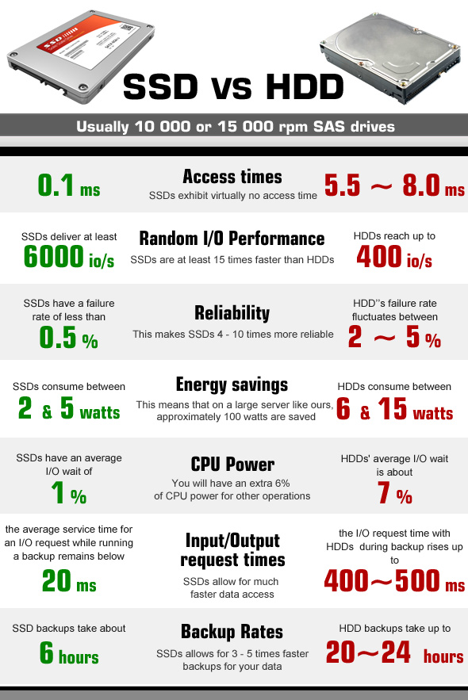
The Emergence of SSDs
Faster
Lower power
No moving parts
But HDDs have their place
Cheapest online storage per byte
Application: Archival storage
CS162 Univ of California Berkeley

Slide 14
Hard Disk Drives (HDD)

Slide 15
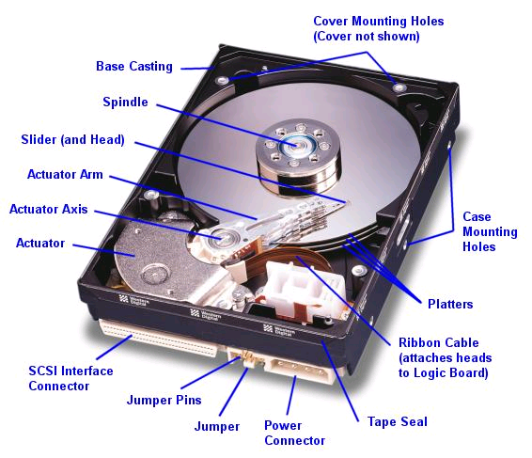
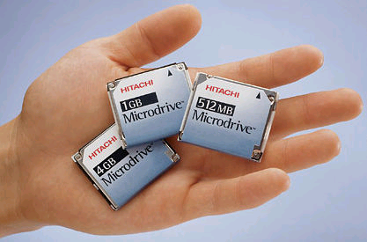
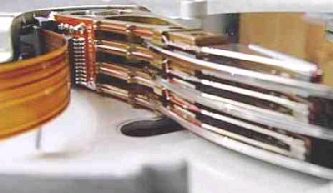
Hard Disk Drivers (HDDs)
IBM/Hitachi Microdrive
Read/Write Head
Side View
IBM Personal Computer/AT (1986)
30 MB hard disk - $500
30-40ms seek time
0.7-1 MB/s (est.)
Western Digital Drive
http://www.storagereview.com/guide/
CS162 Univ of California Berkeley

Slide 16
The Amazing Magnetic Disk
Unit of Transfer: Sector
Ring of sectors form a track
Stack of tracks form a cylinder
Heads position on cylinders
Disk Tracks ~ 1µm (micron) wide
Wavelength of light is ~ 0.5µm
Resolution of human eye: 50µm
100K tracks on a typical 2.5” disk
Separated by unused guard regions
Reduces likelihood neighboring tracks are corrupted during writes (still a small non-zero chance)
CS162 Univ of California Berkeley

Slide 17
Disk platter – top view
Typically sector = 512 bytes
Minimum reading on disk: 1 sector
Can’t read individual byte or word

Slide 18
The Amazing Magnetic Disk
Track length varies across disk
Outside: More sectors per track, higher bandwidth
Disk is organized into regions of tracks with same # of sectors/track
Only outer half of radius is used
Most of the disk area in the outer regions of the disk

Slide 19
Shingled Magnetic Recording (SMR)
Shingled magnetic recording is a magnetic storage data recording technology used in hard disk drives to increase storage density and overall per-drive storage capacity
Overlapping tracks yields greater density, capacity
Restrictions on writing, complex DSP for reading

Slide 20
Review: Magnetic Disks
Cylinders: all the tracks under the head at a given point on all surfaces
Read/write data is a three-stage process:
Seek time: position the head/arm over the proper track –Average of 5-10 ms
Rotational latency: wait for desired sector to rotate under r/w head
4-8 ms (3600-7200 rpm), 2-4 ms (15000ms)
Transfer time: Time to actually read sectors
50-100 MB/sec
Track
Sector
Head
Cylinder
Platter
CS162 Univ of California Berkeley

Slide 21
Bigger Picture
Software
Queue
(Device Driver)
Hardware
Controller
Media Time
(Seek+Rot+Xfer)
Request
Result
Latency = Queue Time + Controller Time + Seek Time + Rotational Latency + Transfer Time
To Achieve Best Bandwidth: Large Transfers of Physically Adjacent Sectors from one track
CS162 Univ of California Berkeley

Slide 22
Disk Performance Example – Self reading
Assumptions:
Ignoring queuing and controller times for now
Avg seek time of 5ms,
7200RPM ⇒ Time for rotation: 60000 (ms/min) / 7200(rev/min) ~= 8ms
Transfer rate of 50MByte/s, block size of 4Kbyte ⇒ 4096 bytes/50×10⁶ (bytes/s) = 81.92 × 10⁻⁶ sec ≅ 0.082 ms per block
Read block from random place on disk:
Seek (5ms) + Rot. Delay (4ms) + Transfer (0.082ms) = 9.082ms
Approx 9ms to fetch/put data: 4096 bytes/9.082×10⁻³ s ≅ 451KB/s
Read block from random place in same cylinder:
Rot. Delay (4ms) + Transfer (0.082ms) = 4.082ms
Approx 4ms to fetch/put data: 4096 bytes/4.082×10⁻³ s ≅ 1.03MB/s
Read next block on same track:
Transfer (0.082ms): 4096 bytes/0.082×10⁻³ s ≅ 50MB/sec
Key to using disk effectively (especially for file systems) is to minimize seek and rotational delays

Slide 23
HDD Controller

Slide 24
HDD Controllers
Old Days: Device driver would address block of data by cylinder number, head (platter) number, and sector number
Now: Hard drive is just an array of sectors
Sector number mapped internally to physical location
Numerically close sectors are probably physically close
Lots of other intelligent features
Error Correcting Codes
Sector Sparing
Slip Sparing
Track Skewing
CS162 Univ of California Berkeley

Slide 25
Intelligence in the Controller
Error Correcting Codes
Disk encodes each sector with additional error correcting code data – allowing it to fix imperfectly read or written data
Sector sparing
Disks are made with tracks and sectors as thin and small as possible
If there are imperfections in a sector, then the sector can not be used for reliably store data
Manufacturers include spare sectors distributed across each surface
Disk firmware or formatting can remap bad sectors transparently to spare sectors on the same surface
Slip sparing
Remap all sectors (when there is a bad sector) to preserve sequential behavior
Helps in retaining good sequential performance by remapping all sectors from the bad sector to the next spare

Slide 26
Intelligence in the Controller
Track Skewing
Sector numbers offset from one track to the next, to allow for disk head movement for sequential operations
Logical sector zero on each track is staggered from sector zero on the previous track
By an amount corresponding to time it takes the disk to move the head from one track to another

Slide 27
Typical Numbers for Magnetic Disk (self reading)
Parameter | Info/Range
Space/Density | Space: 14TB (Seagate), 8 platters, in 3½ inch form factor! Areal Density: ≥ 1 Terabit/square inch! (PMR, Helium, …)
Average Seek Time | Typically 4-6 milliseconds
Average Rotational Latency | Most laptop/desktop disks rotate at 3600-7200 RPM (16-8 ms/rotation). Server disks up to 15,000 RPM. Average latency is halfway around disk so 4-8 milliseconds
Controller Time | Depends on controller hardware
Transfer Time | Typically 50 to 250 MB/s. Depends on: Transfer size (usually a sector): 512B – 1KB per sector Rotation speed: 3600 RPM to 15000 RPM Recording density: bits per inch on a track Diameter: ranges from 1 in to 5.25 in
Cost | Used to drop by a factor of two every 1.5 years (or faster), now slowing down

Slide 28
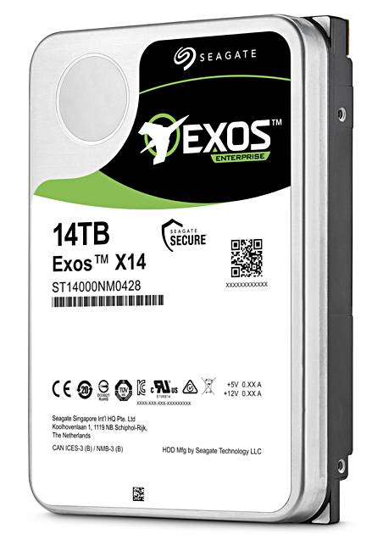
Example of Current HDDs (Self reading)
Seagate Exos X14 (2018)
14 TB hard disk
8 platters, 16 heads
Helium filled: reduce friction and power
4.16ms average seek time
4096 byte physical sectors
7200 RPMs
6 Gbps SATA /12Gbps SAS interface
261MB/s MAX transfer rate
Cache size: 256MB
Price: $615 (< $0.05/GB)
IBM Personal Computer/AT (1986)
30 MB hard disk
30-40ms seek time
0.7-1 MB/s (est.)
Price: $500 ($17K/GB, 340,000x more expensive !!)
CS162 Univ of California Berkeley

Slide 29
Lecture Summary
Hard Disk Drives – had magical run
Tremendous improvement in HDD technology
Smaller sizes
More information
Less power
Low cost
Improved Performance
Higher reliability
A lot of intelligence
SSD are now becoming main stream

